Slide 1
top-down approach
Tran Nguyen Phuong Nhi

Slide 2

TABLE OF CONTENT
What is top-down approach?
How to apply it?

Slide 3
What is top-down approach?
Top-down approach is a problem-solving or design methodology that starts with a broad overview of a system and gradually focuses on the details. Basically, it means breaking something complex into smaller components.
This method emphasizes a high-level view of the system and focuses on defining the system’s structure, interfaces, and interactions before starting with the implementation details.

Slide 4
ADVANTAGES
DISADVANTAGES
Breaking problems into parts help us:
Identify what needs to be done.
New parts will be less complex.
Part of solution may turn out to be reusable.
Allows more than one person to solve the problem.
Breaking problems into parts help us:
May lead to assumption about low-level components.
Making change can be challenging.
May cause cascading effects.
Lacks of communication.

Slide 5
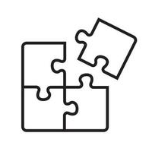

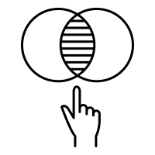
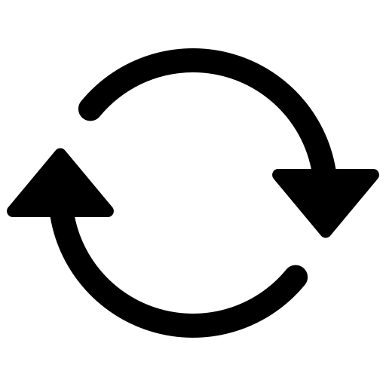
HOW TO APPLY IT?
Identify the problem
Break it down into smaller problems
Solve each problems
Repeat steps 2 and 3 until problem solved

Slide 6
Build a website for hospital
Homepage
About us
Foundation
Network
Location
Specialties
Community
Vision
Map
Contact information
General information
Packages
Location
Book appointment
News
Feedbacks

Slide 7

Thank you

